Slide 1
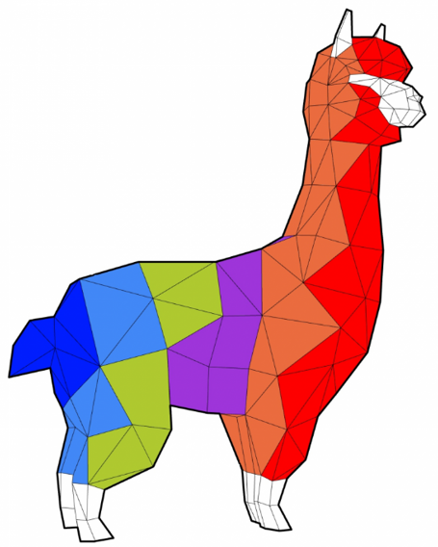
Lunch Talk - 220222
Marco Pellegrino
Alpaca4d
where a wi-fi exists
World WRD LGBT
alpaca4d.github.io

Slide 2
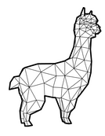
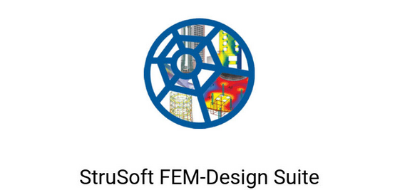
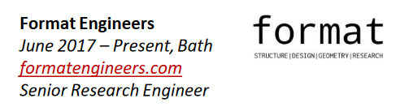

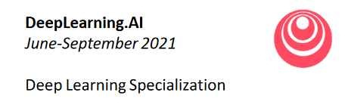
About Me
Next Week

Slide 3
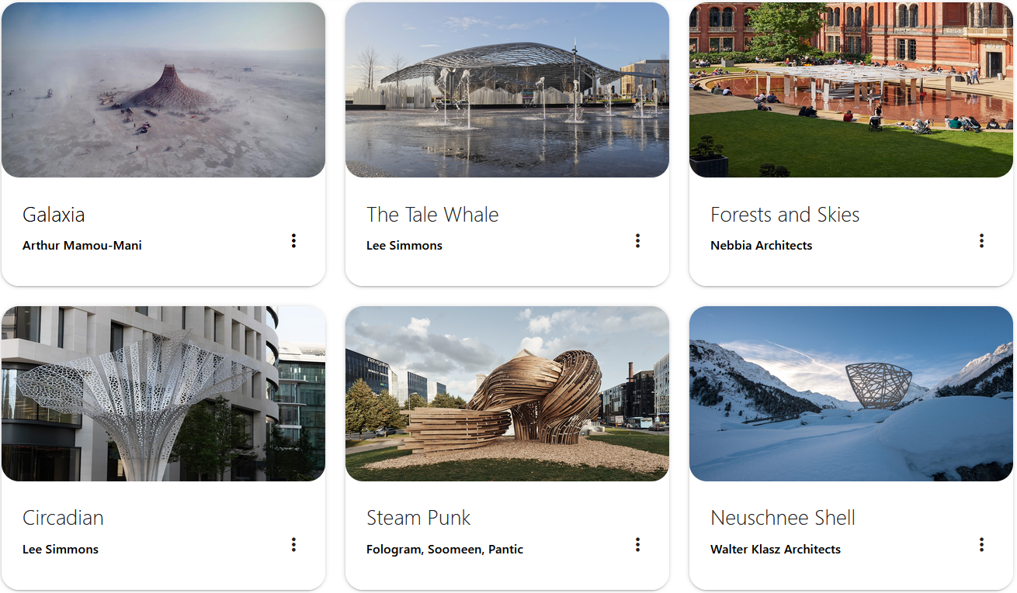

Slide 4
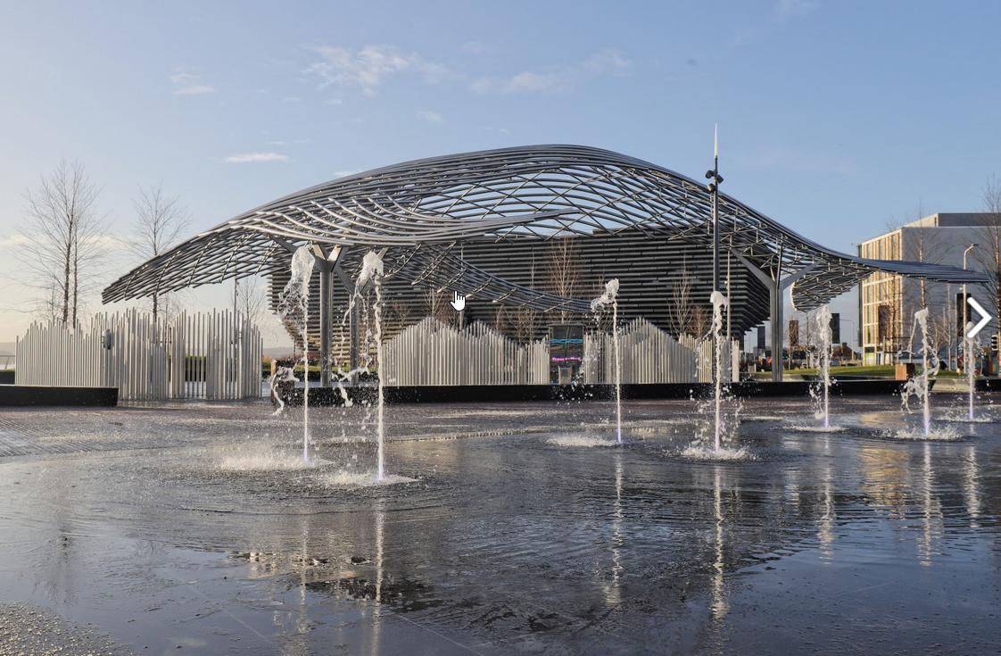
Lee Simmons

Slide 5
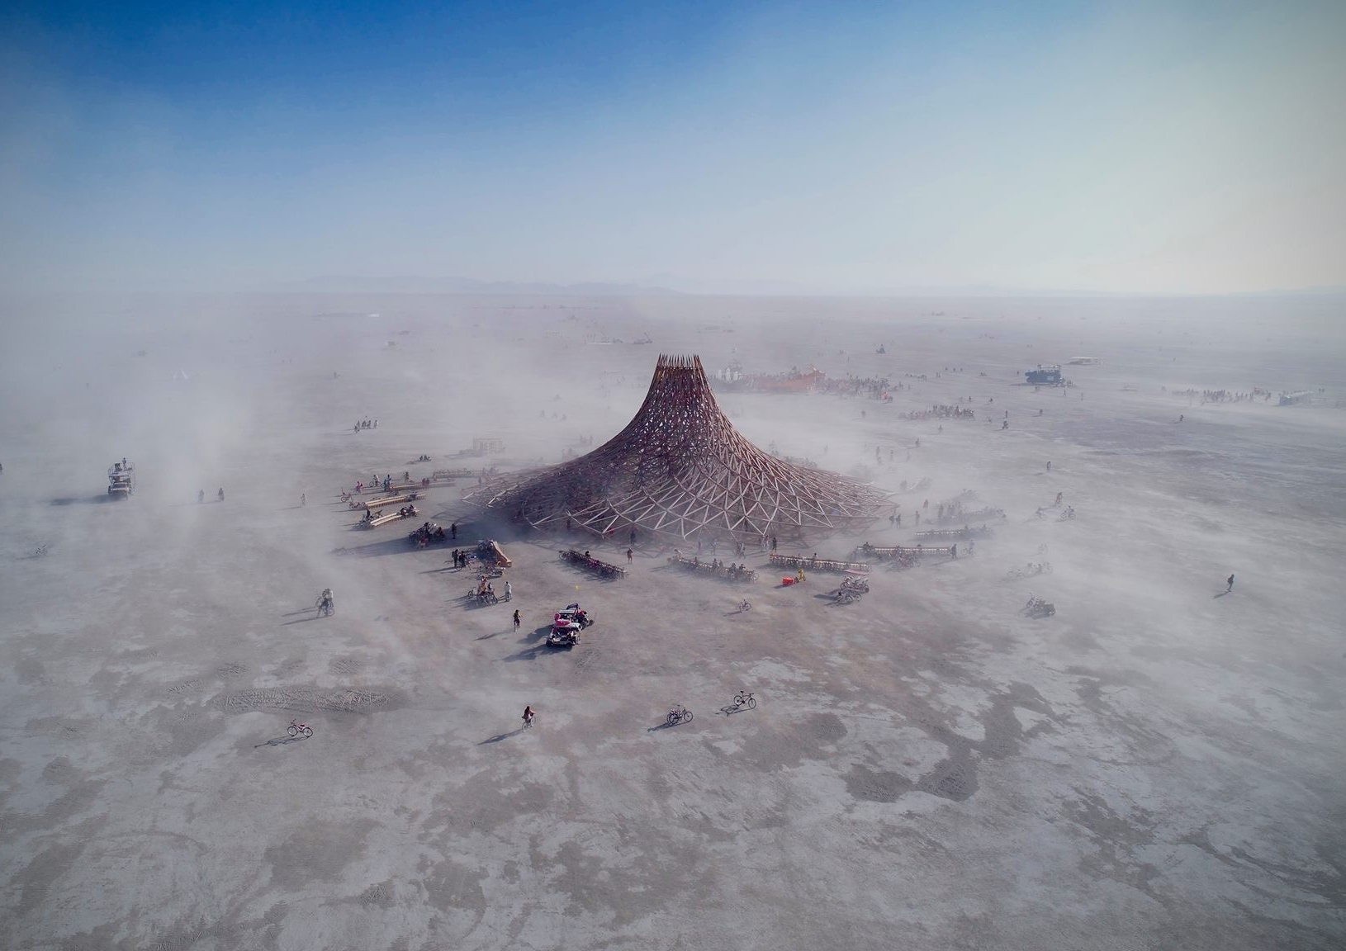
Arthur
Mamou-Mani

Slide 6
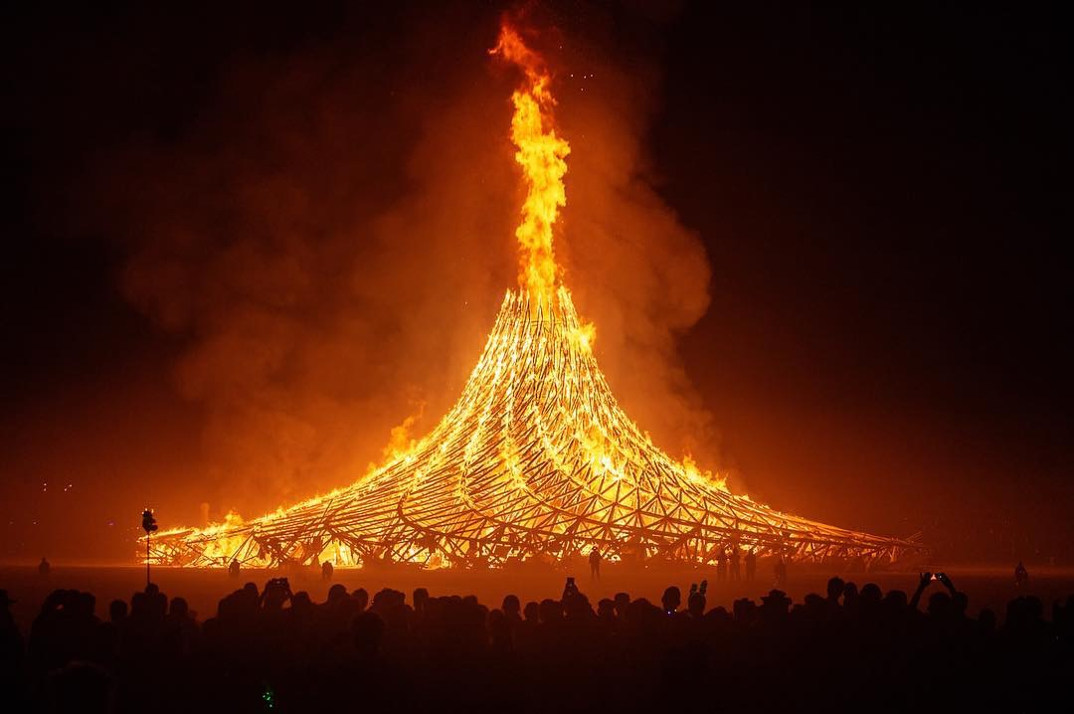
Arthur
Mamou-Mani

Slide 7
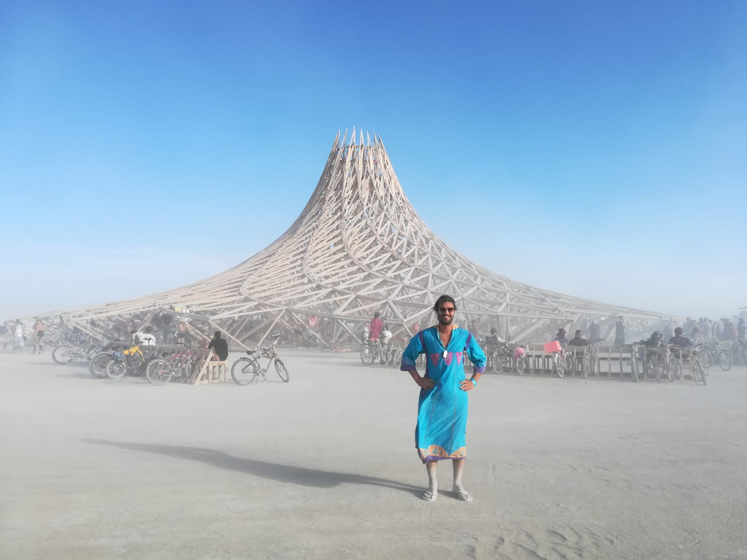
My bike

Slide 8

marco-pellegrino.github.io

Slide 9

Friday 04 September 2020
“Alpaca antibodies could prevent coronavirus infection in humans, study suggests”

Slide 10
Tuesday 08 November 2020

Slide 11
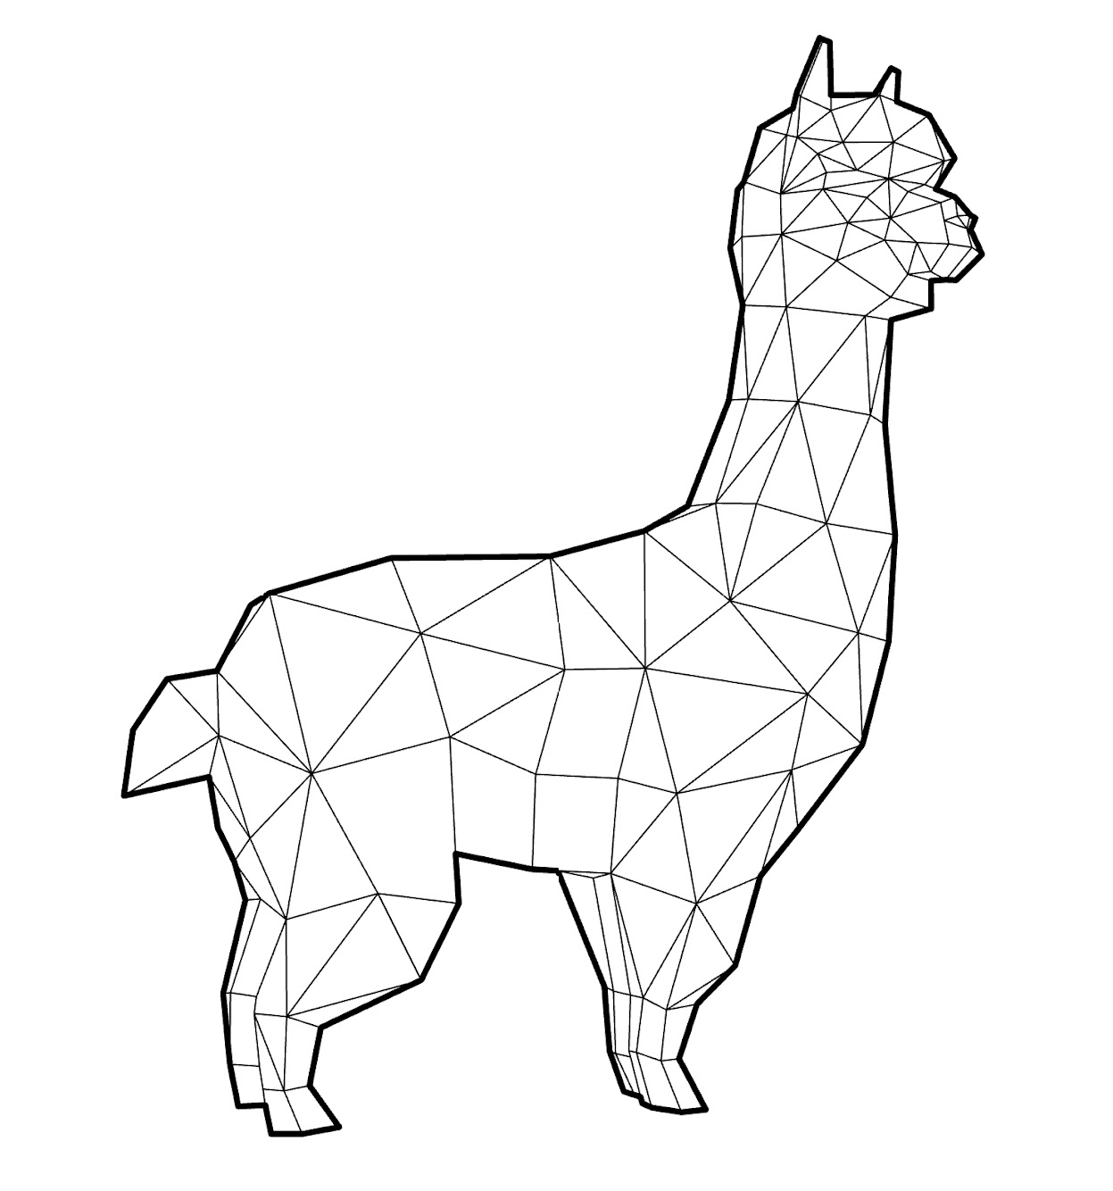
Alpaca4d
A revolutionary Parametric FEA software

Slide 12
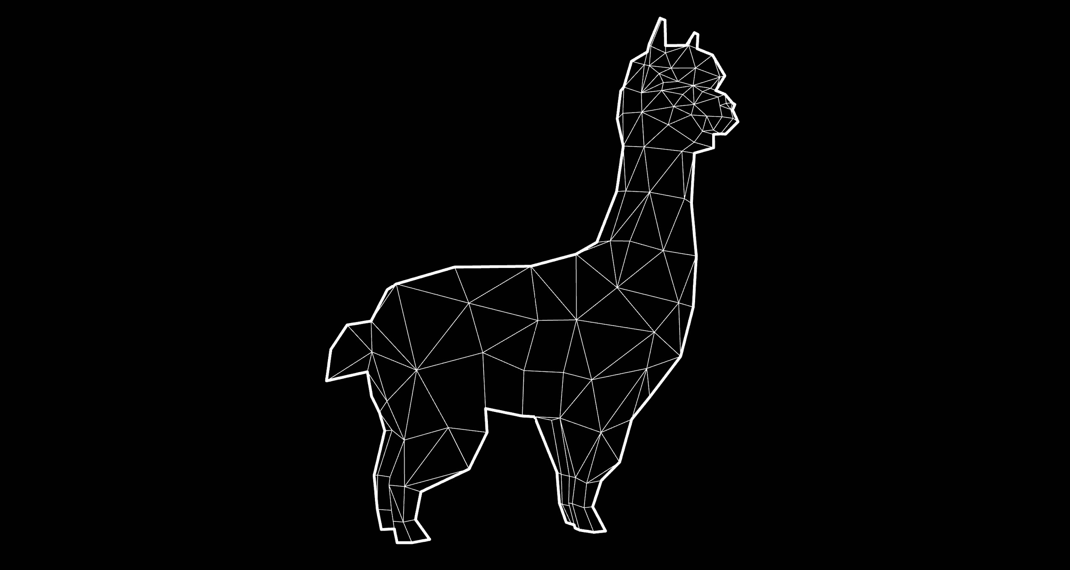

Alpaca4d
A revolutionary Parametric FEA software

Slide 13


Introduction
Alpaca4d is a Grasshopper plugin which has been developed on top of OpenSees
The library is mostly used by researchers and academia because of the not user-friendly behaviour even if the math behind the library is highly sophisticated
🎓
👩‍🔬👨‍🔬
The main idea of Alpaca4d is to provide an efficient and easy way to use OpenSees without writing any line of code.
The belief is to bring more users to perform structural analyses with Opensees in a parametric environment such as Grasshopper.

Slide 14
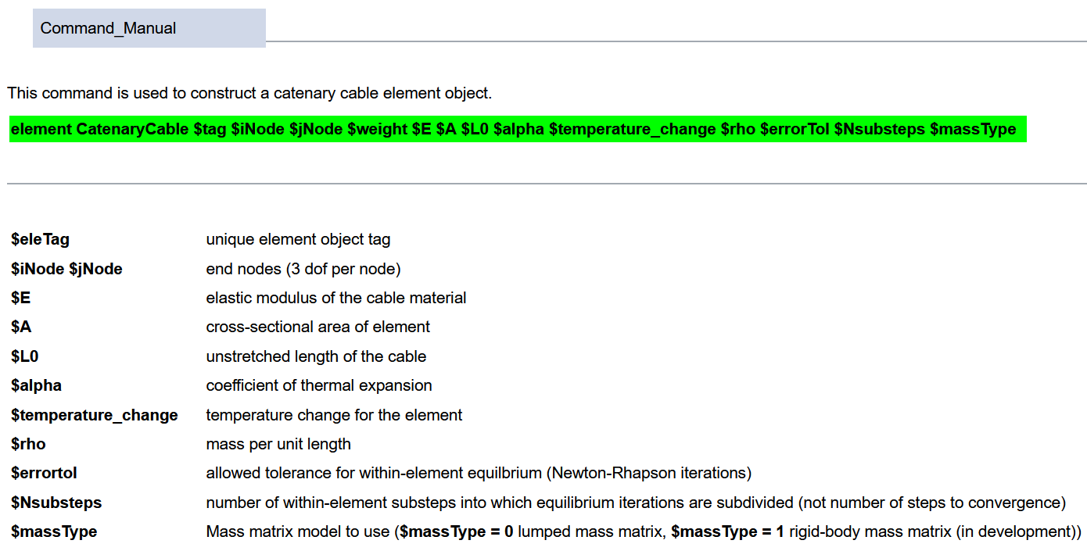
Introduction
https://opensees.berkeley.edu
i.e. Catenary Cable

Slide 15
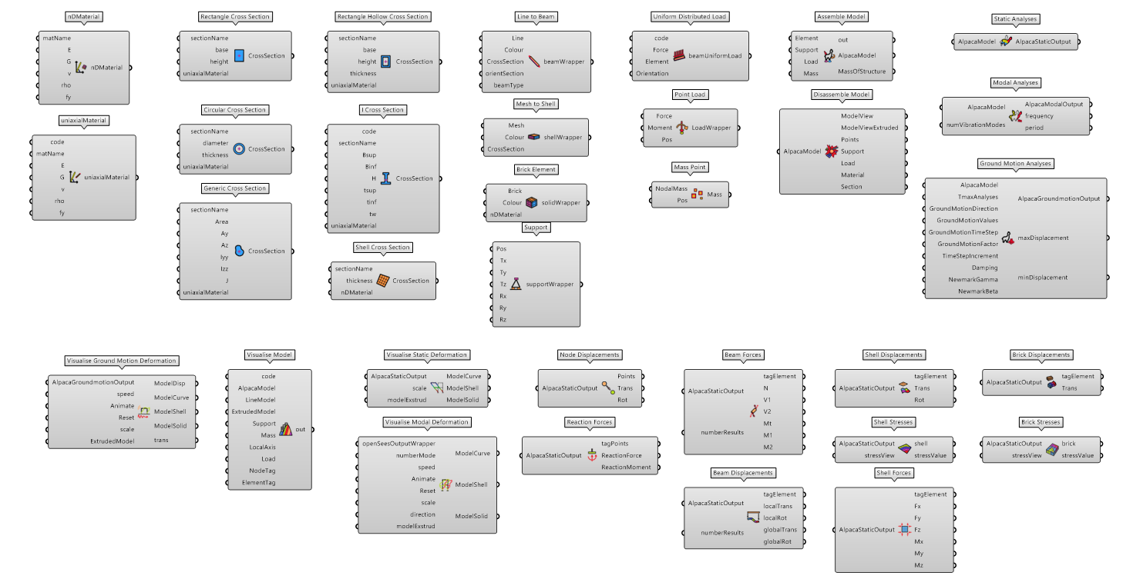
Plug-in
Materials
Cross Sections
Elements
Loads
Assemble/
Disassemble
Analysis
Visualisation
Numerical Computation

Slide 16
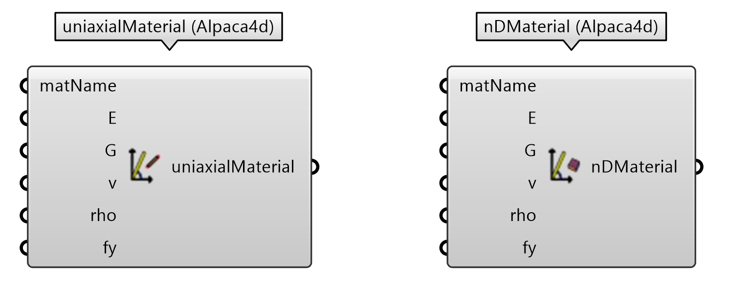
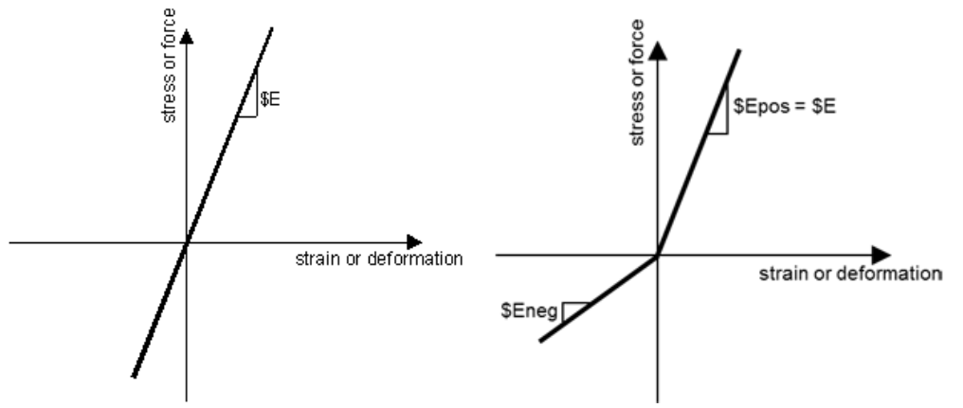
Materials
UniaxialMaterial is used to construct a material object which represents uniaxial stress-strain relationships. The implemented relationship is Linear Elastic.
NDMaterial is used to construct a material object which represents the stress-strain relationship at the gauss-point of a continuum element. The behaviour is an Elastic Isotropic.

Slide 17
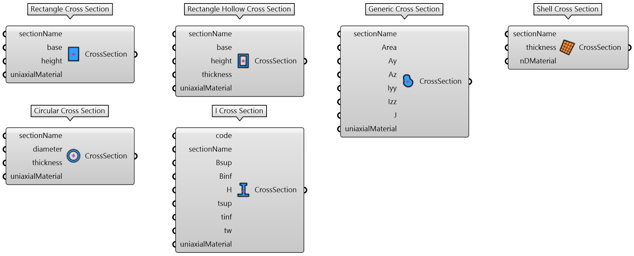
Cross Sections
Solid rectangle section, Circular Hollow Section, Rectangular Hollow Section, I-Section and Generic Cross Section are provided to the users to assign mechanical properties to a beam element.
Constant thickness section has been implemented for shell elements.
Beam Cross Sections
Shell Cross Section

Slide 18
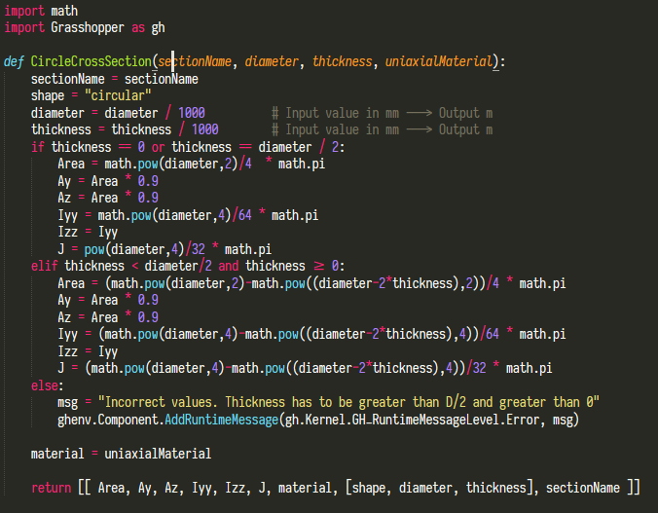
Cross Sections

Slide 19
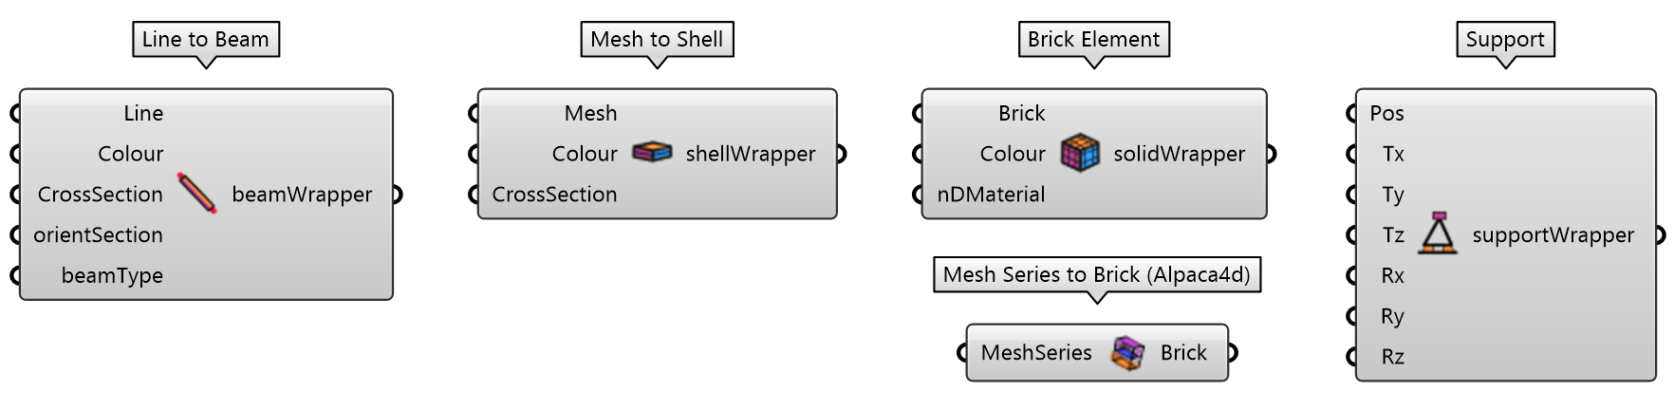
Elements
The finite elements implemented are Elastic Timoshenko Beam Column Element, ShellMITC4-ShellDKGT, bbarBrick.
Line to Beam component converts a line geometry to a Timoshenko Beam.
Mesh to Shell component converts a mesh geometry to a Shell Element. Shell elements are used to model structures in which one dimension, the thickness, is significantly smaller than the other dimensions. Triangular faces will be converted to a ShellDKGT formulation and the Quad faces to a ShellMITC4 formulation.
Brick Element component converts an hexahedral element into a bbarBrick. A hexahedron is any polyhedron with six faces. It is generally a difficult task to convert a generic solid into a set of hexahedron and MeshSeriesToBrick component might help to construct some simple polyhedron.

Slide 20
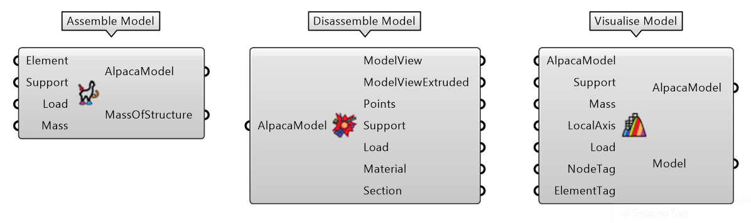
Assemble
Element and Support are the minimum input that the user should provide to perform an analysis.
Assemble Model builds a text file with the necessary information to be sent to OpenSees solver. The mass of the structure is automatically calculated from the assemble component.
Disassemble Model retrieves some text information to double check that the model has been assembled correctly.
Visualise Model is a graphical representation of the structure. The model output is either an extruded model or lines model.

Slide 21
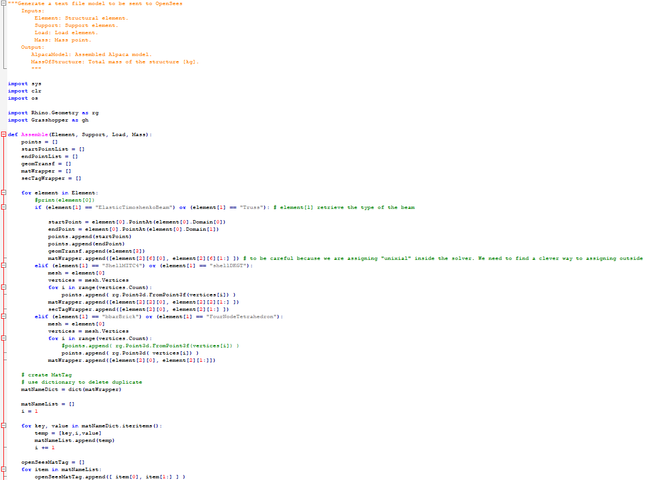
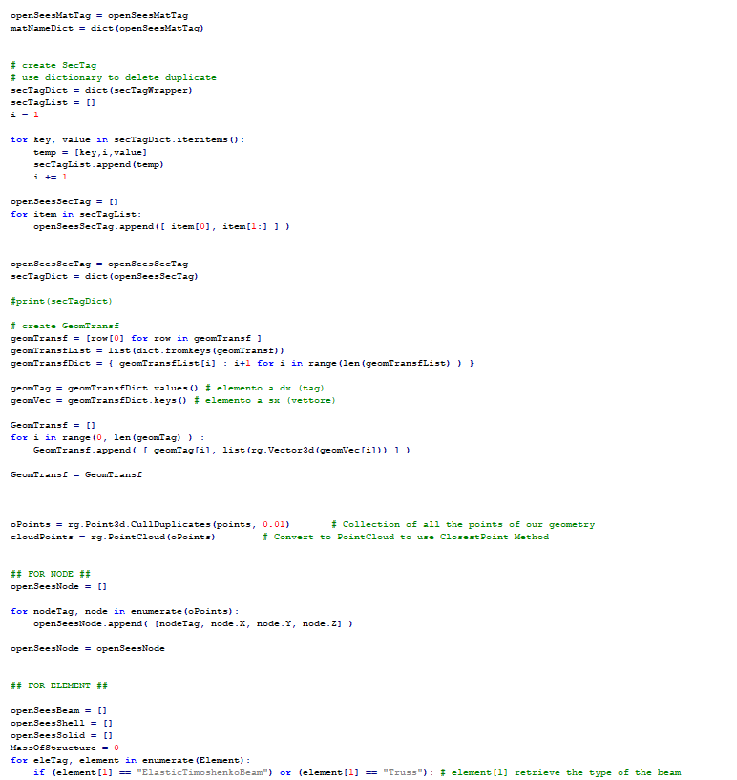
Assemble

Slide 22
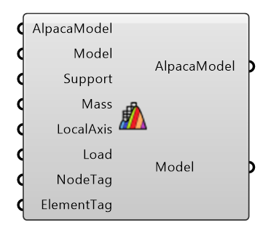
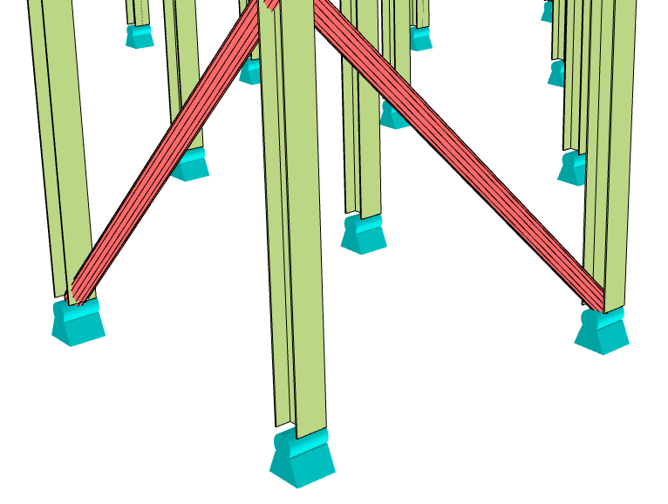
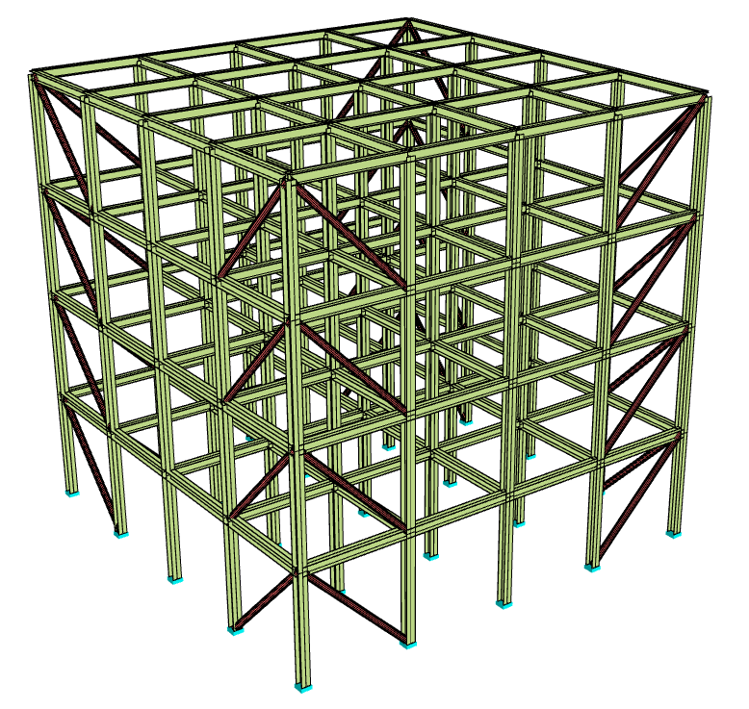
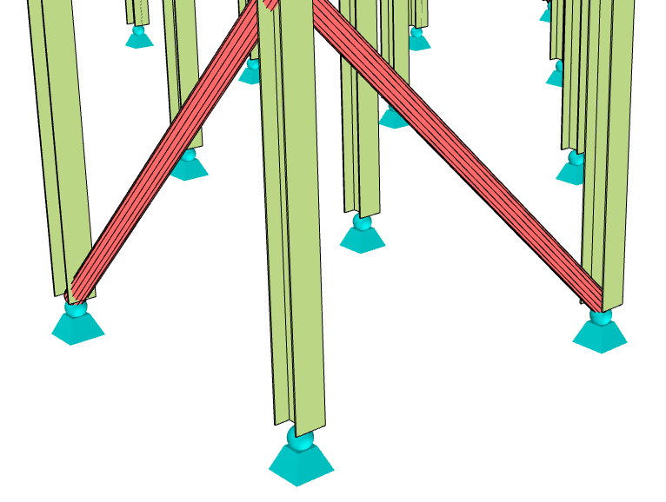
Visualise

Slide 23
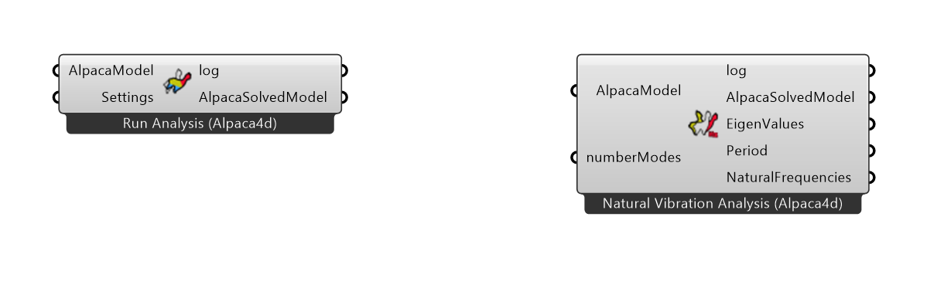
Analysis
Alpaca 4d can perform Static Analysis, Modal analysis, Ground Motion Analysis and 3NDF Analysis (WIP-Brick Elements).
Static Analysis describes the response of the structure under a static load.
Transient Analysis computes the behavior of the structure during the time. Ground Motion values/time step are a list of numbers that describe the ground motion of an earthquake.
Modal Analysis computes the Modal shapes of the structure and returns the period and frequency of that mode.

Slide 24
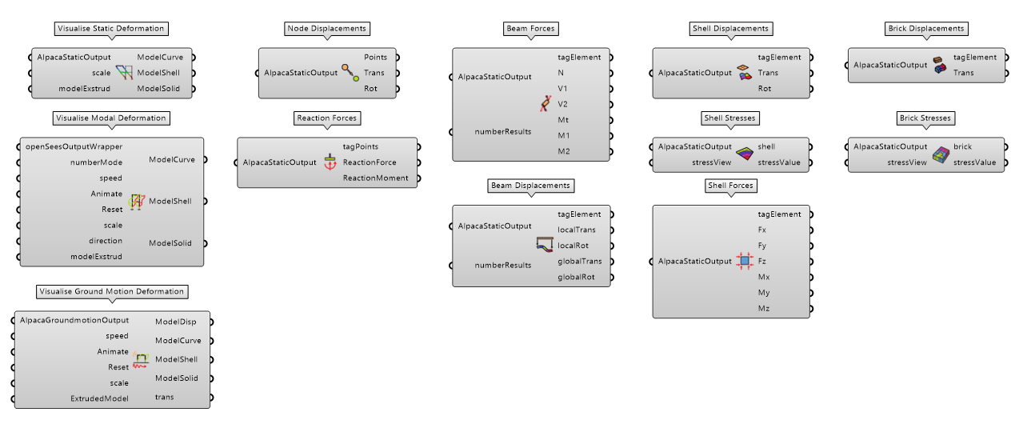
Numerical Computation and Visualization
The static analysis returns the numerical outputs to study the behaviour of the structure. It is possible to query results for Point, Beam, Shell and Brick elements.
The visualization tool has been implemented for all types of analyses.

Slide 25
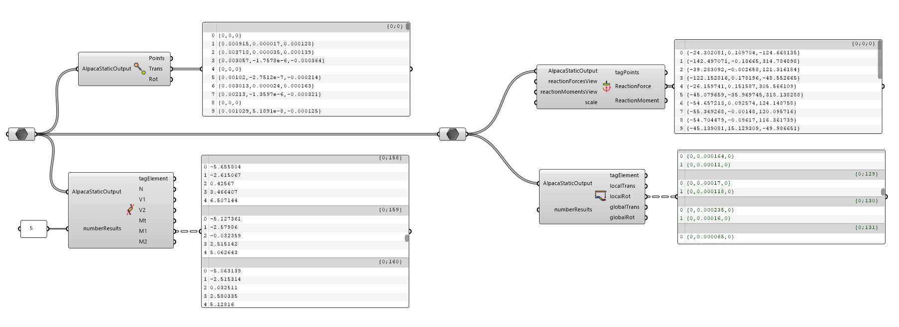
Numerical Computation and Visualization

Slide 26
Numerical Computation and Visualization

Slide 27
What Can I analyse?

Slide 28
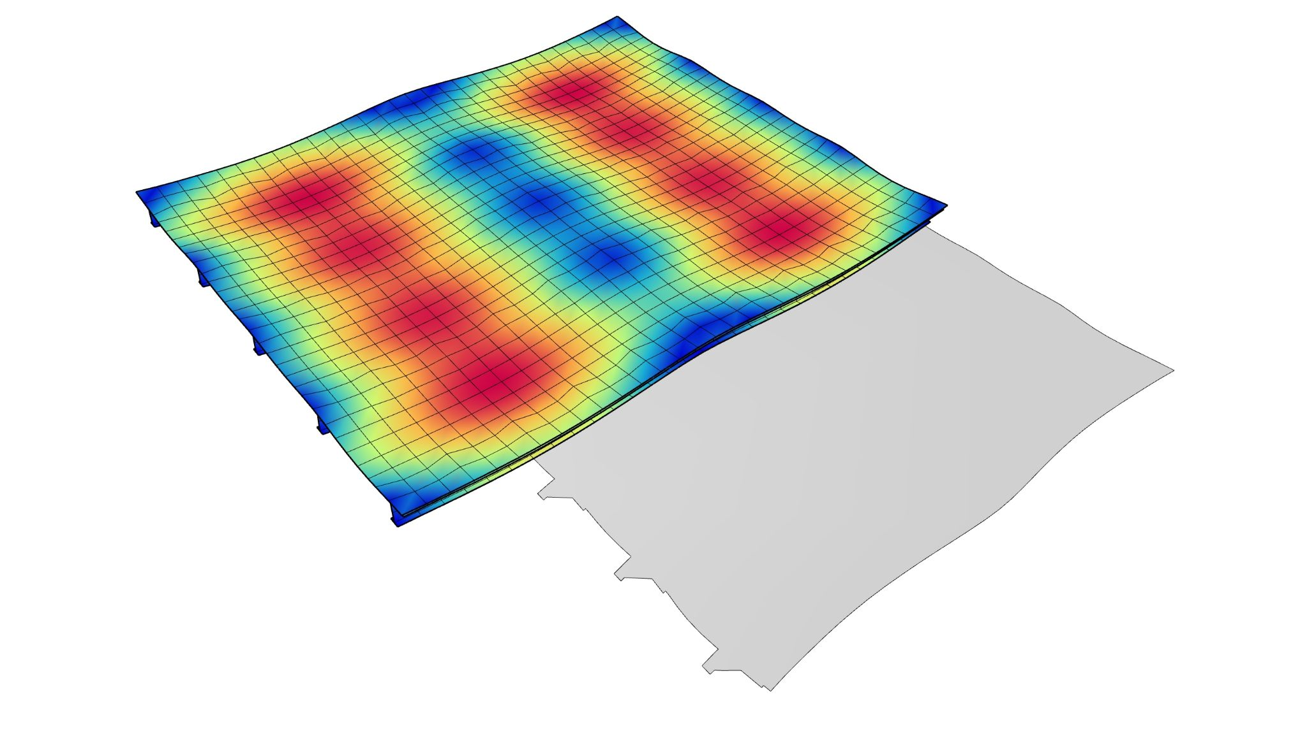
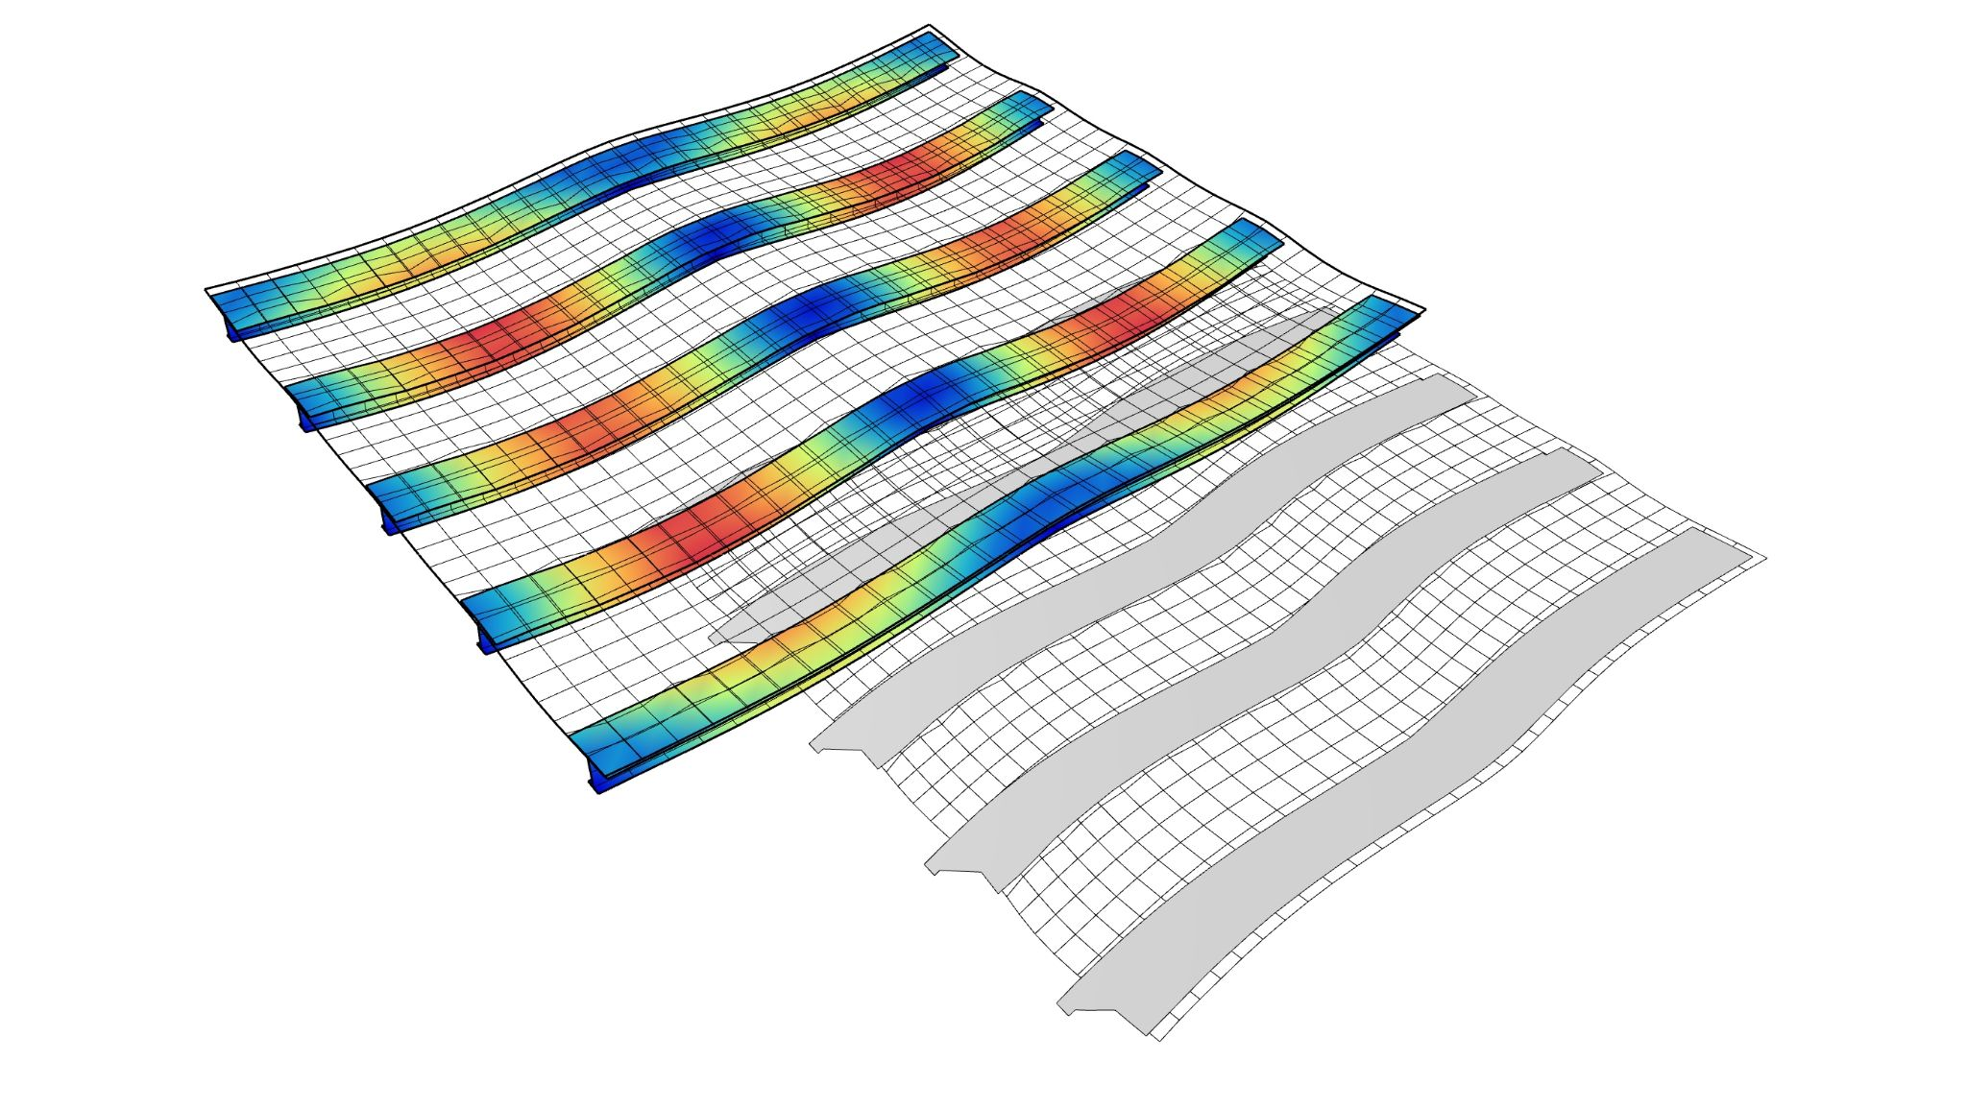
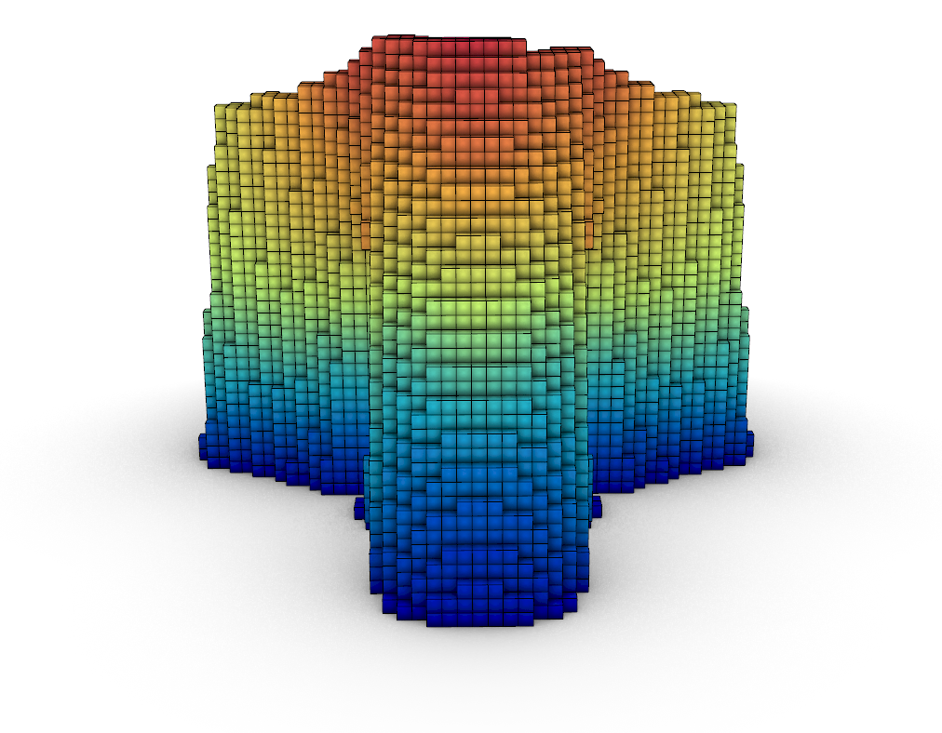
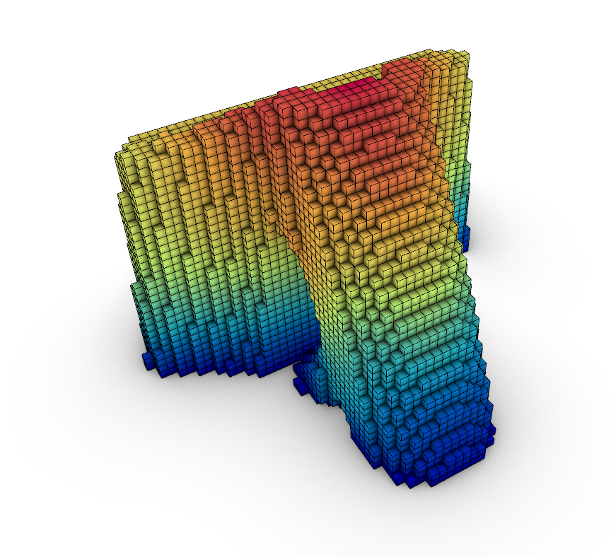
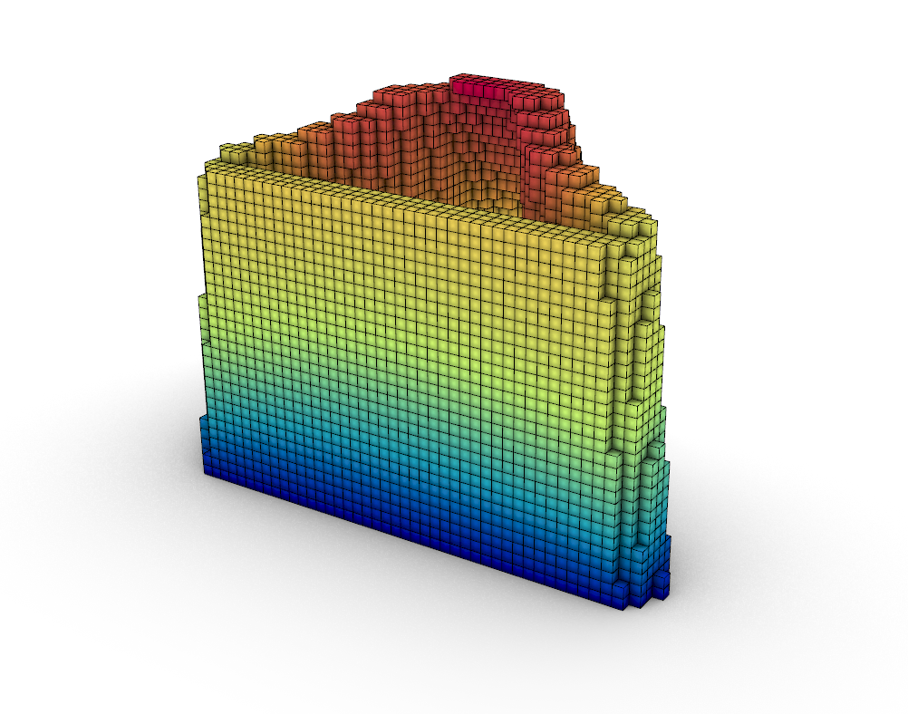
Examples

Slide 29
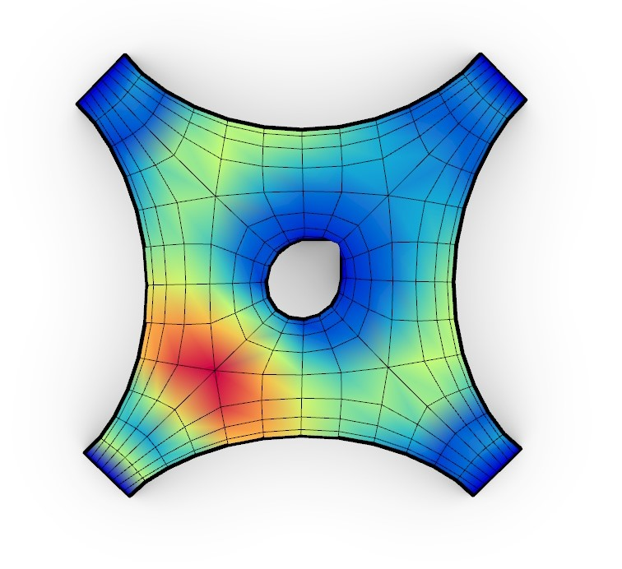
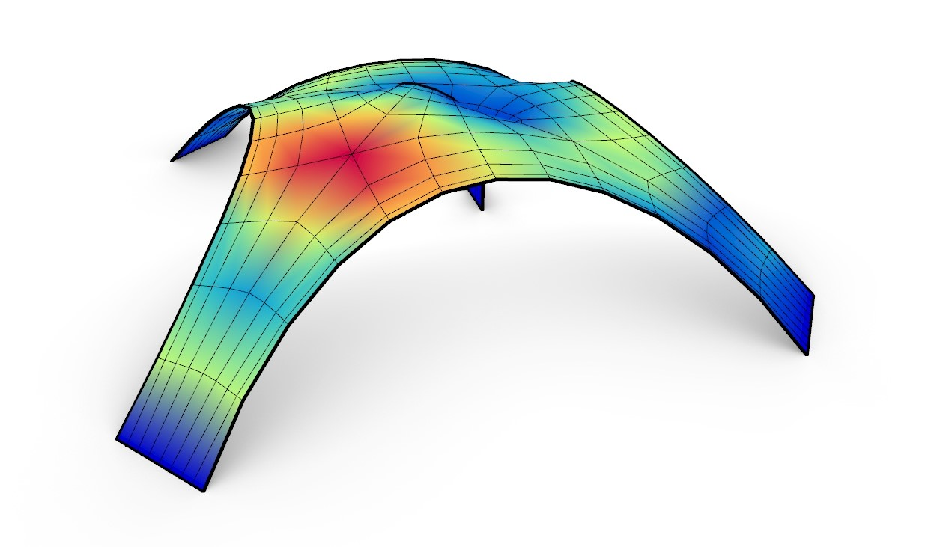
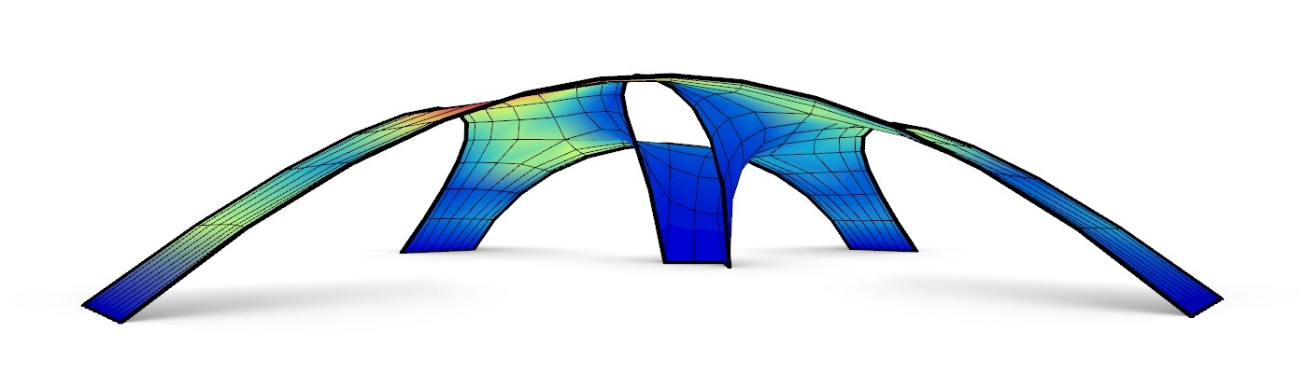
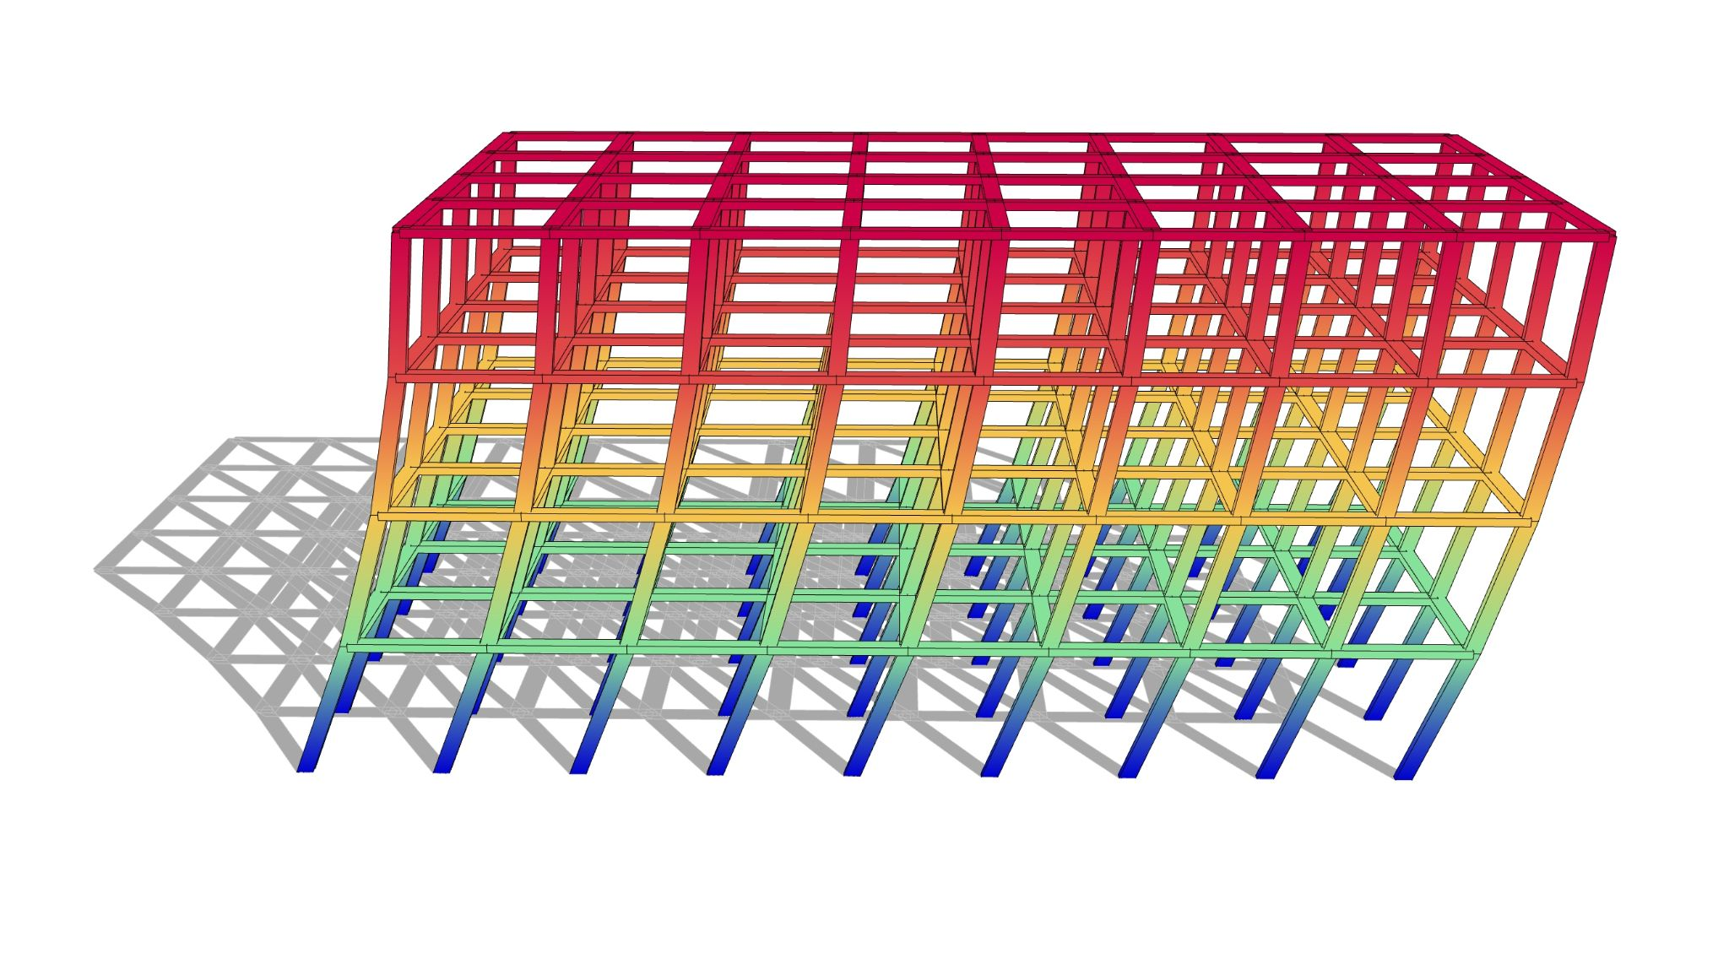
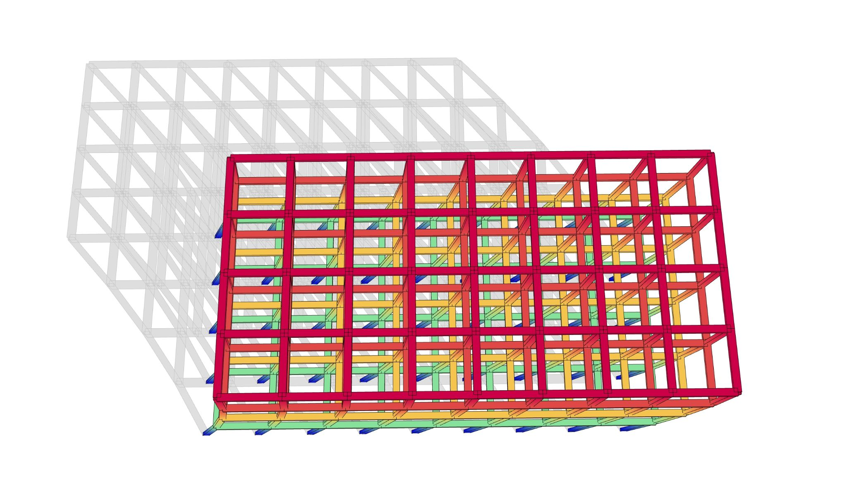
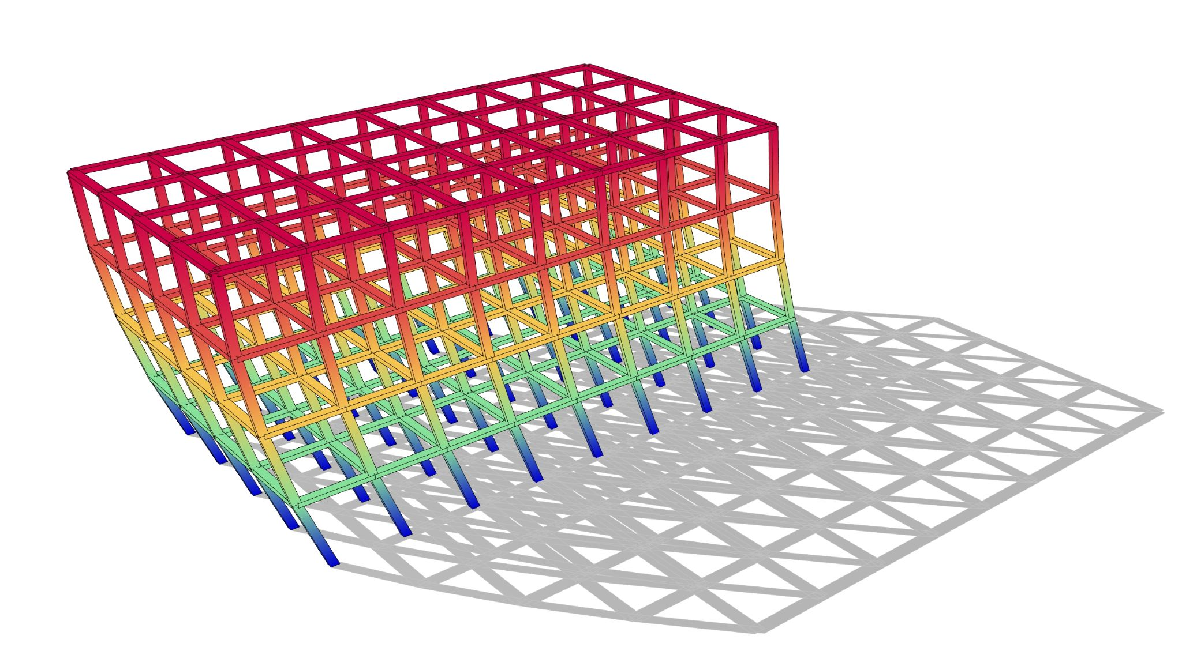
Examples

Slide 30
Examples

Slide 31
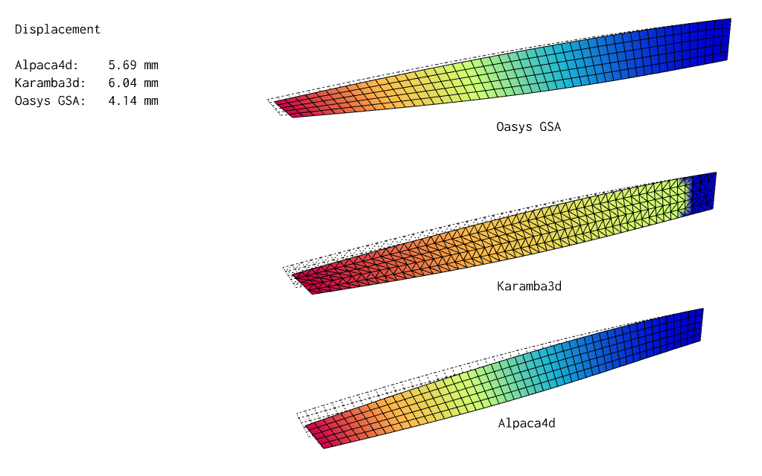
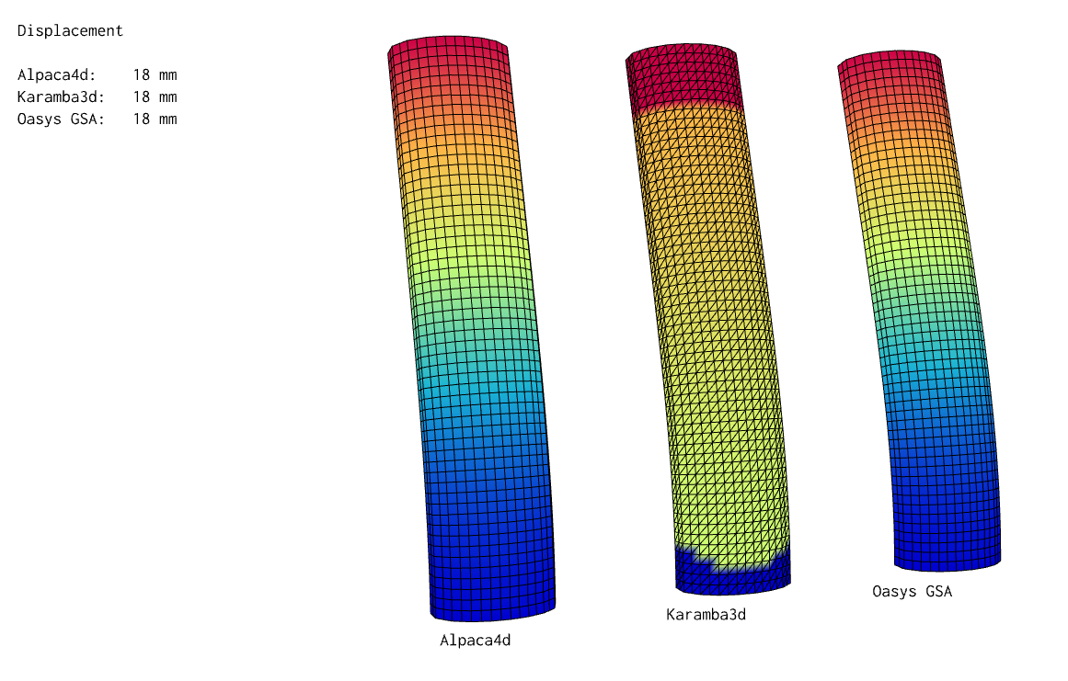
Benchmark
Analytical solution = 5.68 mm

Slide 32
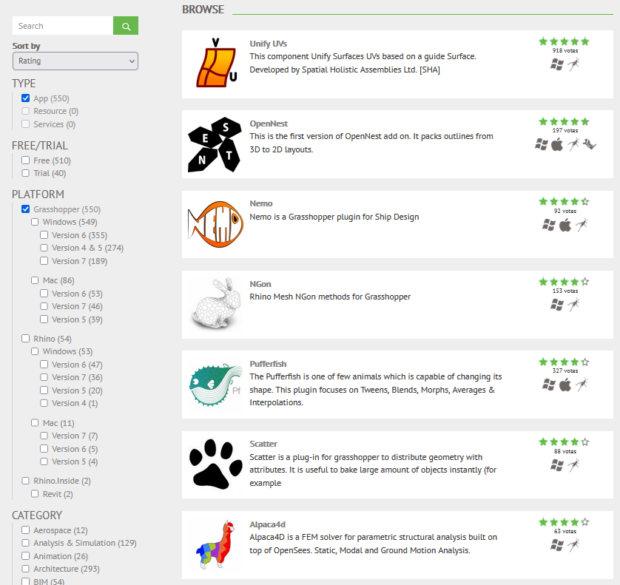
User Feedback
7th

Slide 33
Does it look like Karamba3d, right?

Slide 34

vs
Alpaca4d
Pro
First parametric FEA
Fast Solver
Cross Section Optimiser
Cons
Only Linear Material
Not Open-Source
Poor shell elements
No Brick Elements
Not Free
Pro
Open-Source code in C++
Complex Analysis:
Linear
Non linear
Static
Dynamic
In the process of validation
User in Academia (i.e. UCL)
Free/Donation
Cons
Slow (for now)

Slide 35
How Slow is Slow?

Slide 36
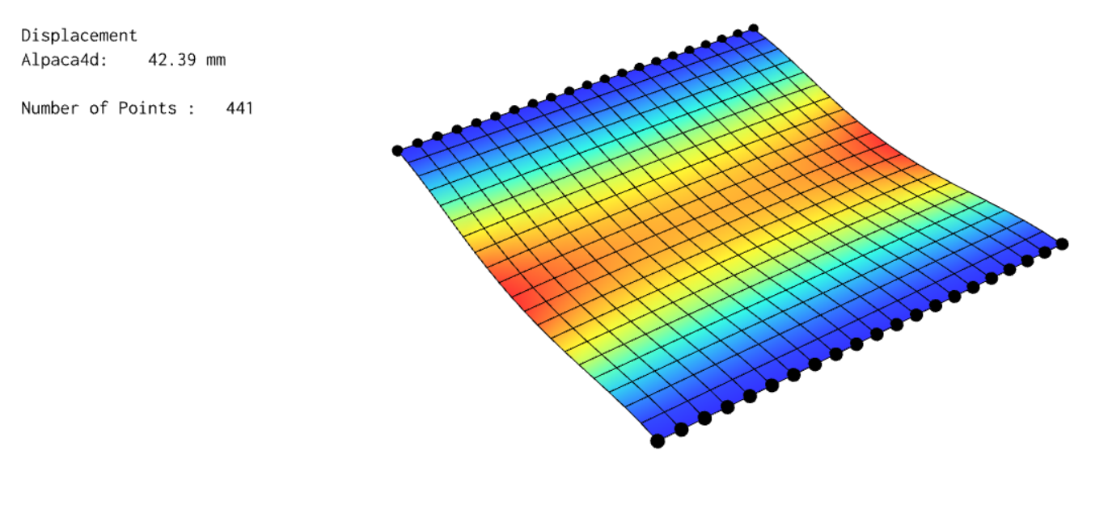
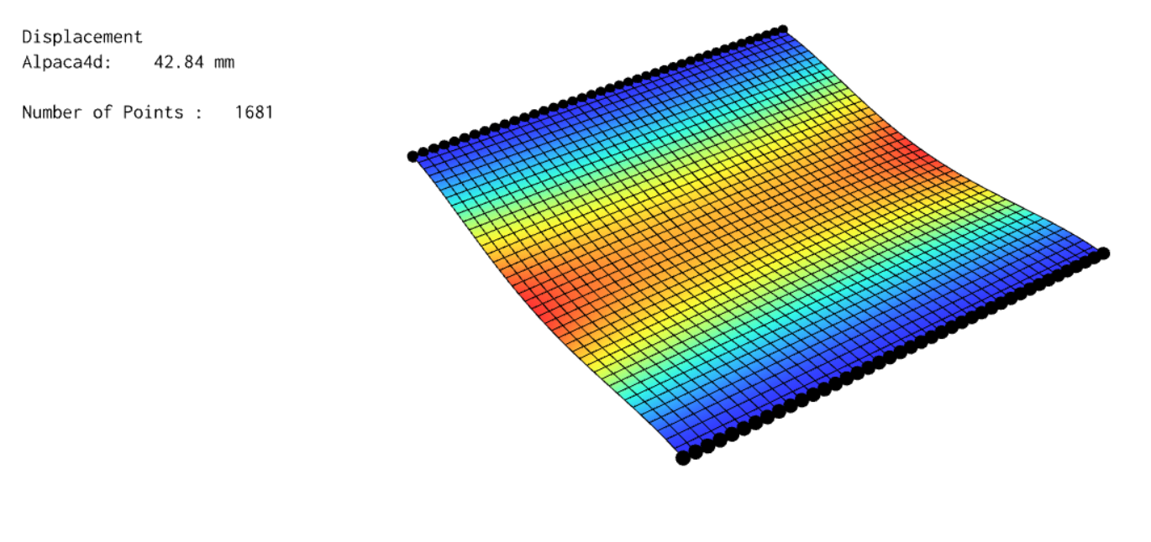
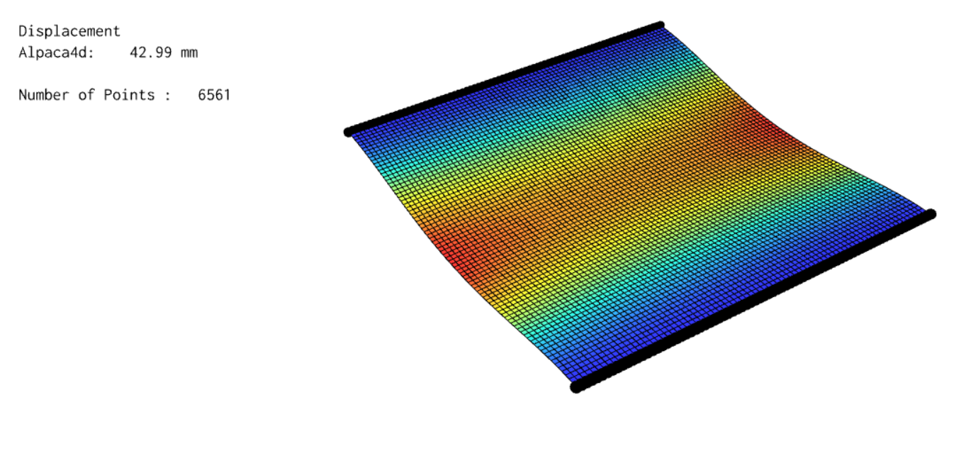
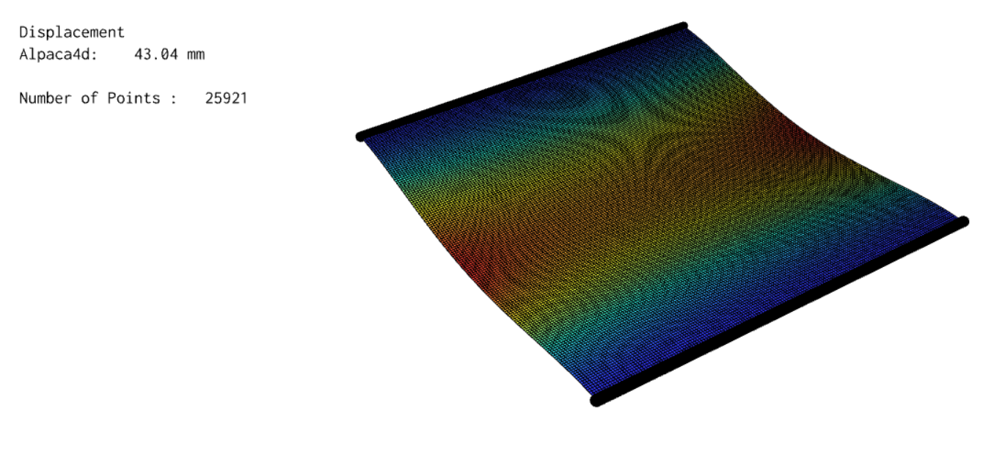
Computing Time
Number of points: 441
Computing time: 0.35 s
Number of points: 1681
Computing time: 1.3 s
Number of points: 6561
Computing time: 13.0 s
Number of points: 25921
Computing time: 3.7 min

Slide 37
WIP
Technical aspect
Create a scalable architecture of the tool. Class, Method, ect.
Use of .tcl interpreter instead of Python
Visualisation tool for .tcl file
Machine Learning
Implementation of new element
Environmental aspect
Implementation of Timber Check by Eurocode tool.
Embodied Carbon tool
Belief
Fix your own bug and don’t wait for the software house customer support
Make your own custom script and share it with the community
Give back to the open source community

Slide 38


Alpaca4d
Alpaca4d
alpaca4d.github.io

Slide 39
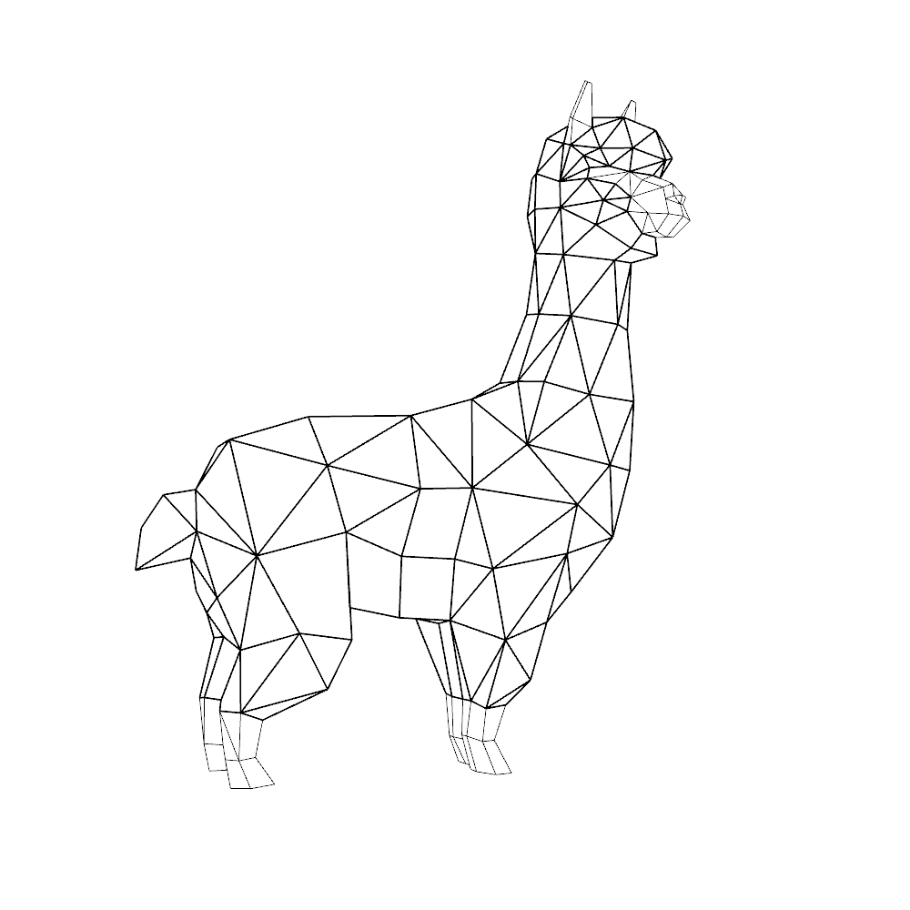
Live Example

